Slide 1
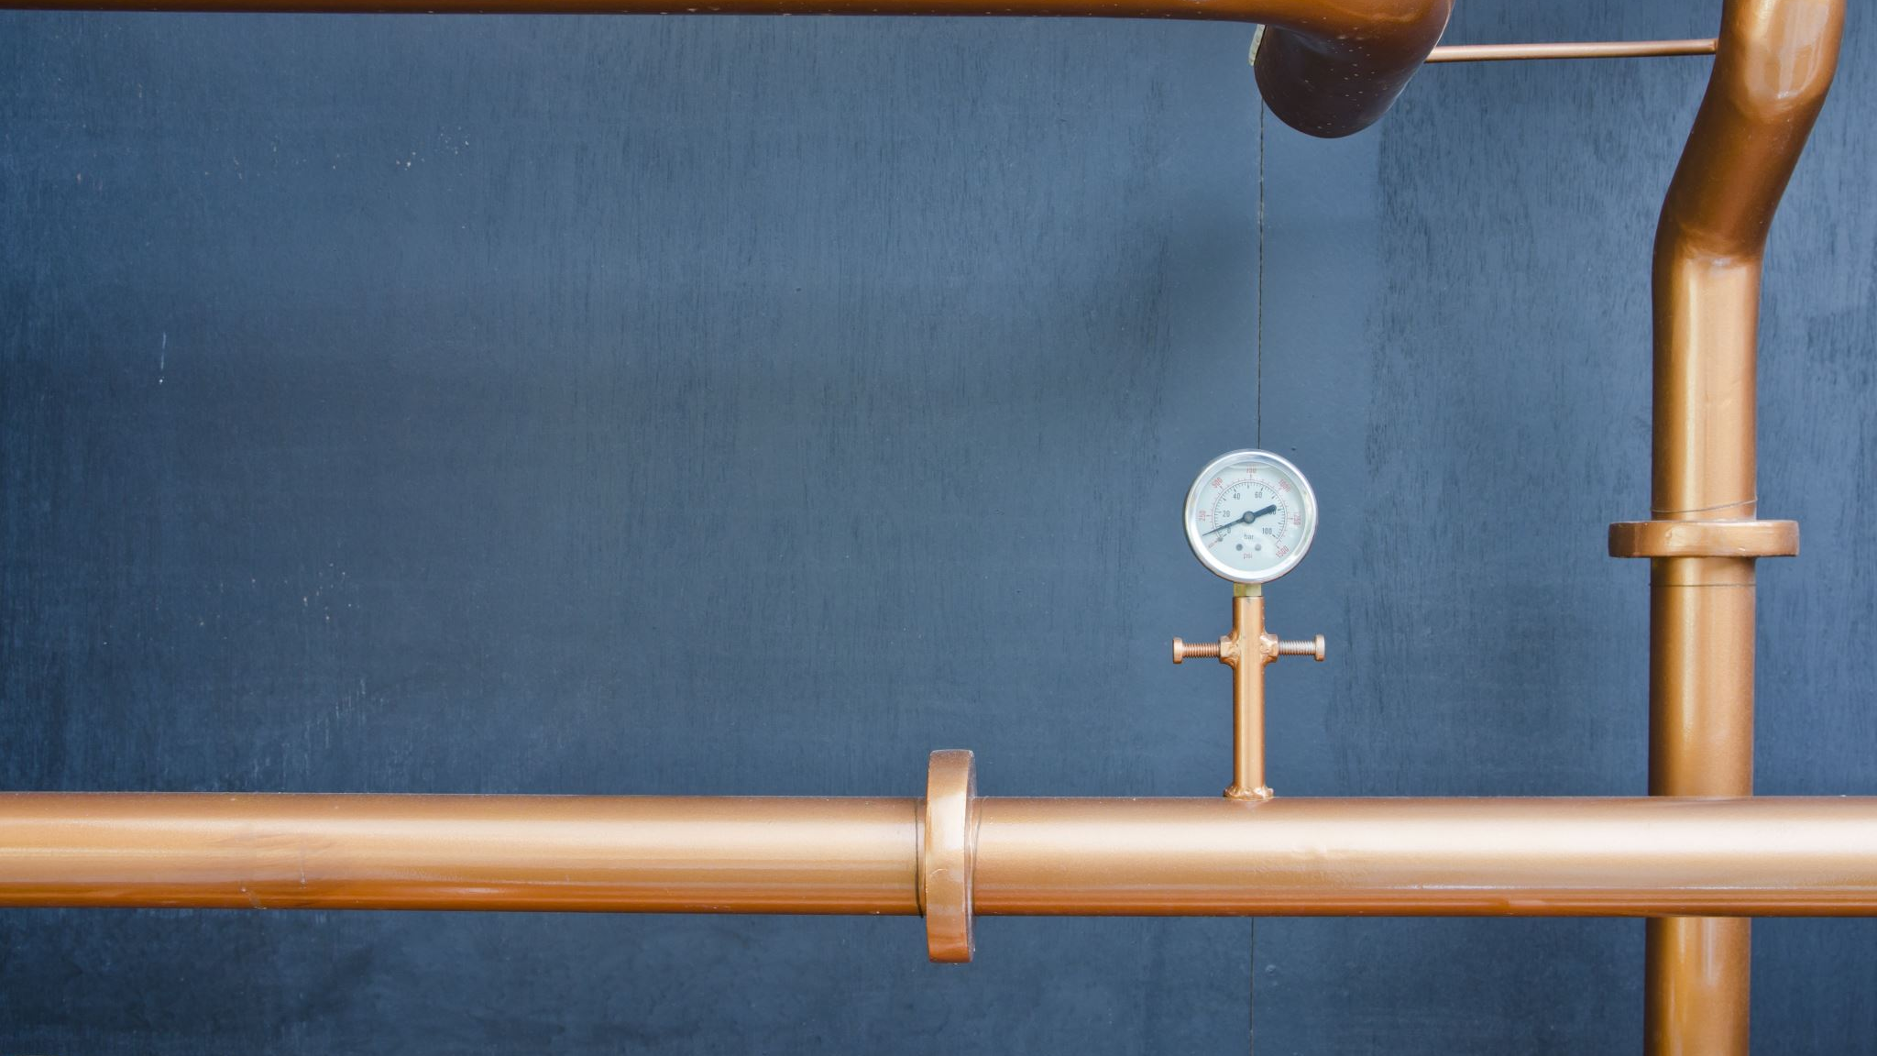
RAILWAY PIPE BENDING

Slide 2
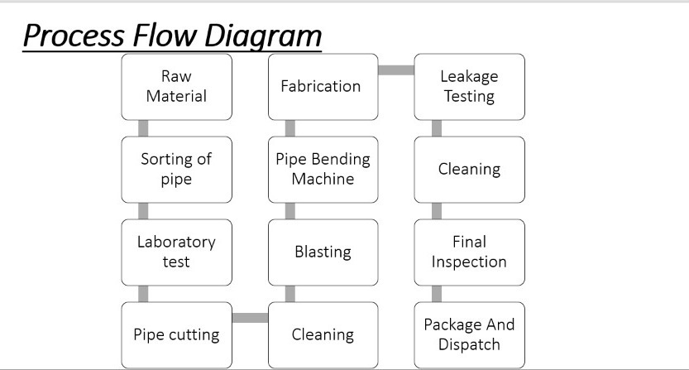

Slide 3
Process Flow Diagram
Raw Material ( From M/s Cooper India Company, Mumbai )
Sorting of pipe according to OD (outer diameter) in various section
Piece of pipe i.e. 200mm cut is send to laboratory for various test
Pipe Cutting
Removal Of Corrosive Part from raw material (pipes)
Pipe Bending using Pipe bending machine.(M/s Electroi Pneumatics Engg)
There are two categories :-
1) Direct Pipe Bending (Small Pipe)
2) Several Process, later Pipe Bending
Leakage testing is taken place to prevent any fault in job.
Cleaning process
Applying Thinner Oil to prevent corrosion
Checking Quality and overall dimension accurately with help of fixture.
Packing and Dispatching

Slide 4
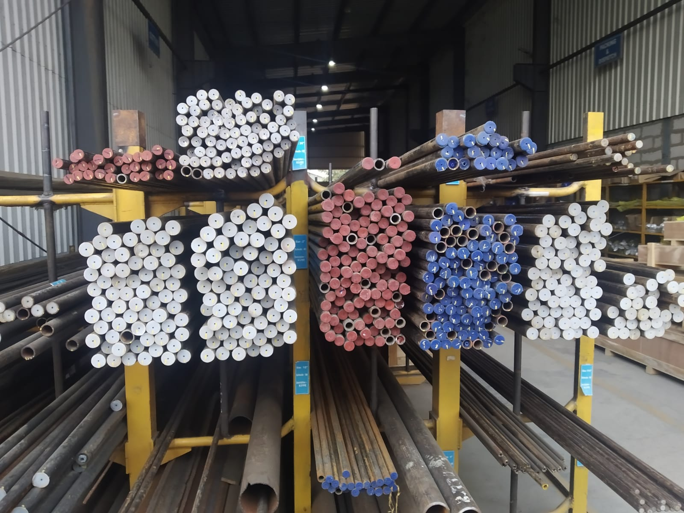
PROCEDURE FOR PIPE BENDING:-
First of all, raw material is brought from Copper India Pvt Ltd, Mumbai. Pipes are sorted according to schedule(unit for pipe) and outer diameter in rack
Pipe cutting is done according to size if pipe's OD(outer diameter) is small then it is cut manually (with help of cutting tool) and if OD is large then it is cut with help of machine.

Slide 5
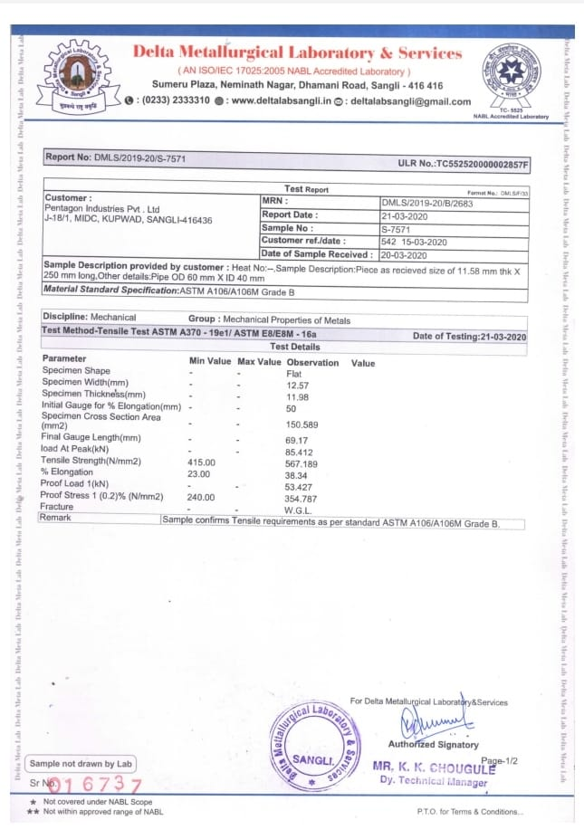
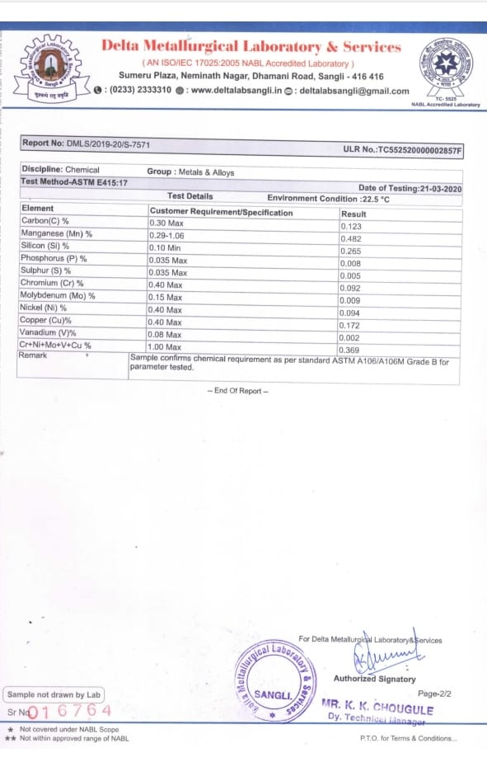
Pipe Laboratory Test
A cut of 200mm pipe of each OD is send to laboratory for various test so as to check raw material is of same grade which we had ordered.
Pipe is of material ASTM (American Society for Testing and Materials) 106 Grade B.
Two test are performed in UTM Machine
1.Mechanical
2.Chemical
Test are verified, later processed for further processing.

Slide 6
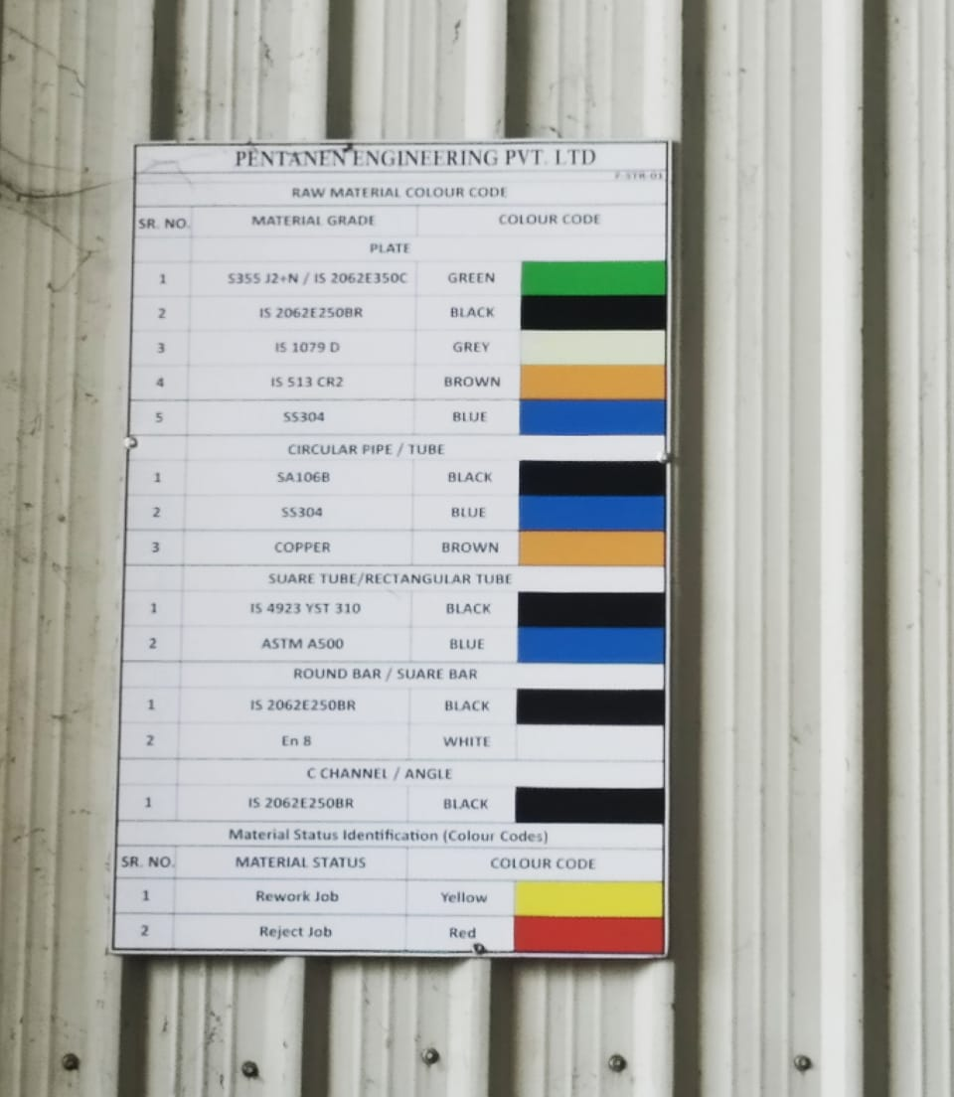
PIPE CLASSIFICATION
Pipes are classified into different sections accordingly and are verified ,finally yellow mark is used for rework job and red color is rejected material.

Slide 7
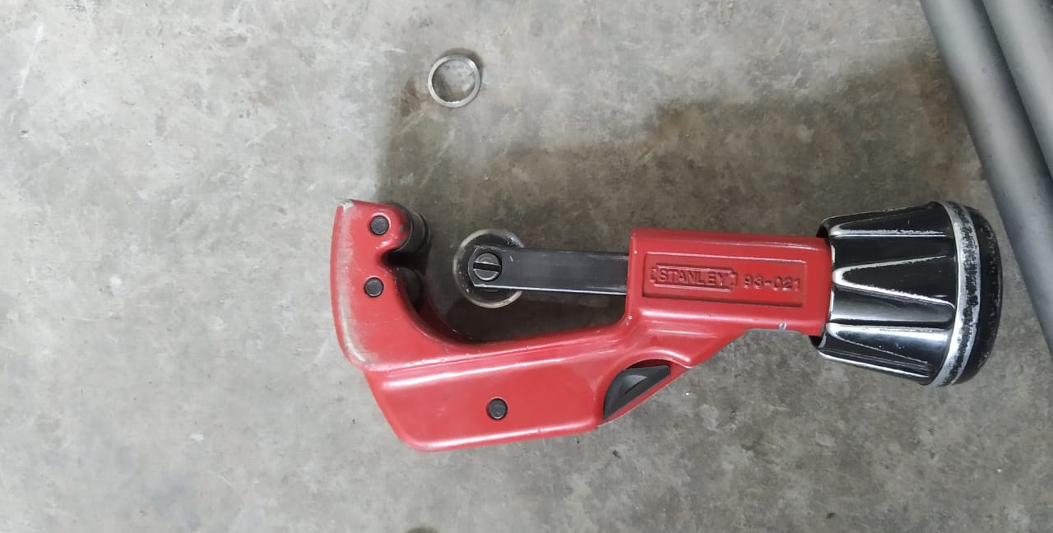
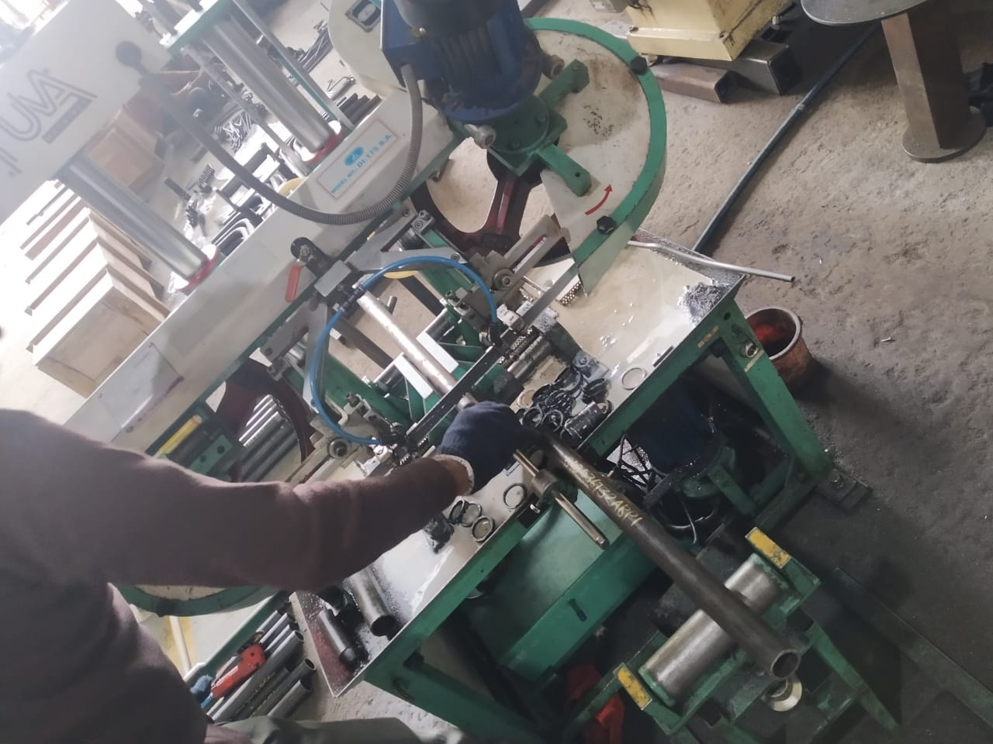
PIPE CUTTING PROCESS
Pipe cutting is done in two ways:-
1) Manual Pipe Cutting
2) Machine Pipe Cutting

Slide 8
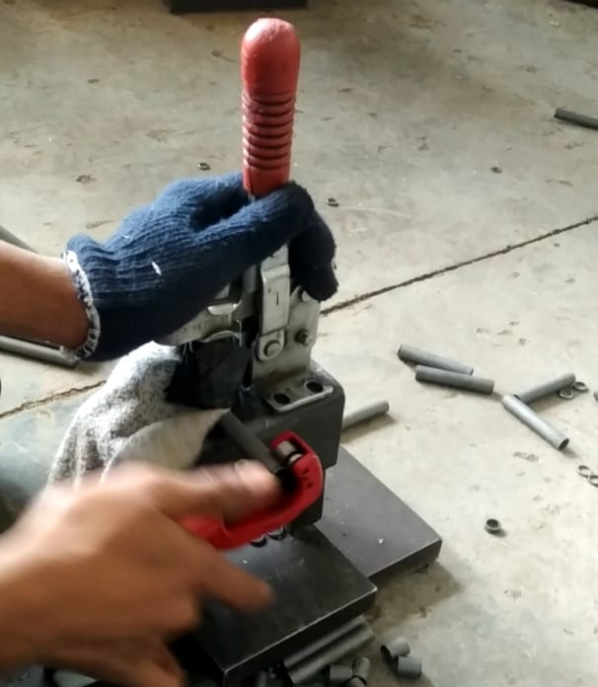
Manual Pipe Cutting
In this process, the helper cuts the pipe of with the help of cutting tool, measure the distance on pipe and mark a line on pipe and rotate the tool by fixing it on surface, rotates the tool and creates a cut and unused part is cut from job. This tools and can cut the pipe whose OD lies between 3mm to 32mm. This tool is used to cut the small OD pipes

Slide 9
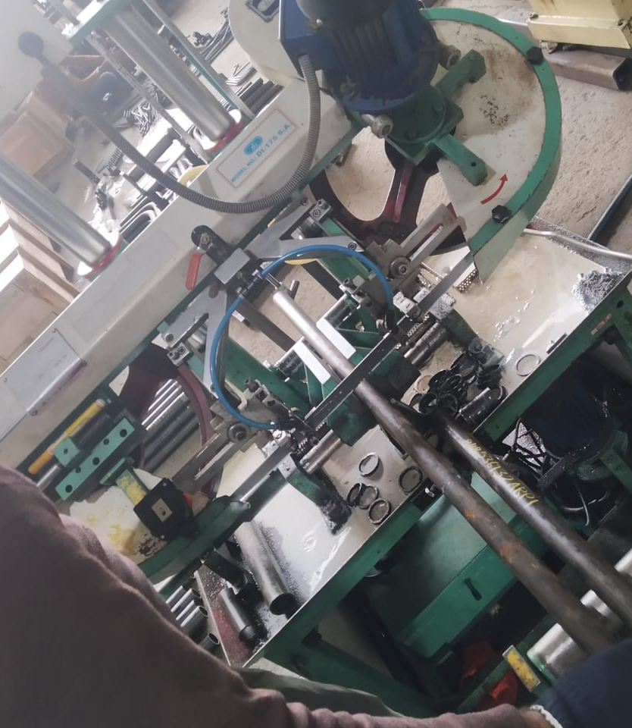
Bandsaw Machine
In this process, pipe having large outer diameter is used for cutting it into pieces before sending to removal of rust. Bandsaw Machine have a long blade placed horizontally in it and cutting oil is used to overcome friction while cutting. Now pipe is placed in middle of the machine and machine cuts it according to requirement helper has to hold it until it cuts. White color like cutting oil is their while the process of cutting takes place at the point of cut. Later pipe is cut into two pieces and processed ahead.

Slide 10
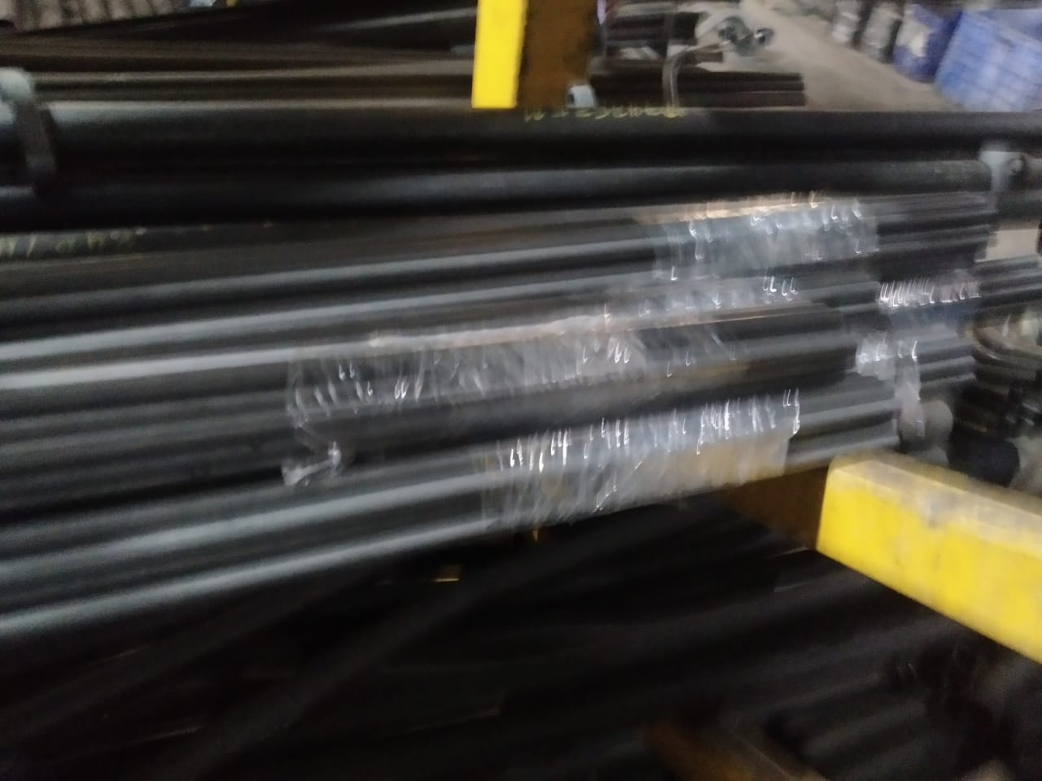
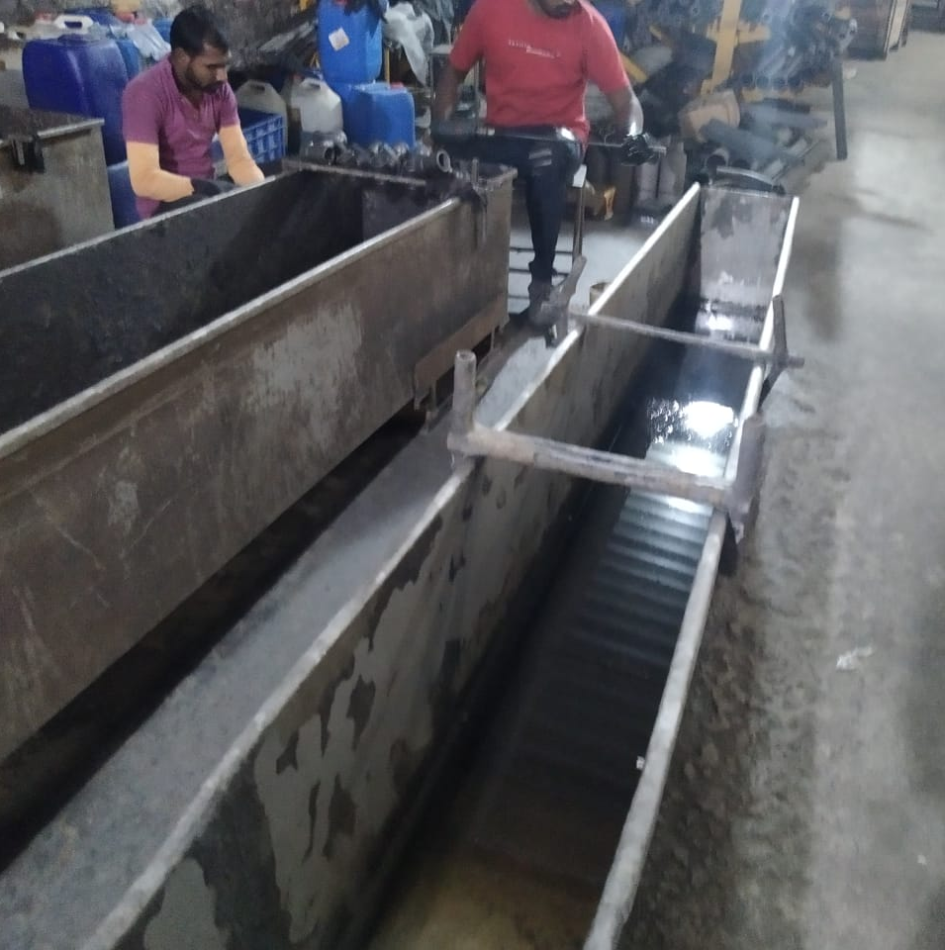
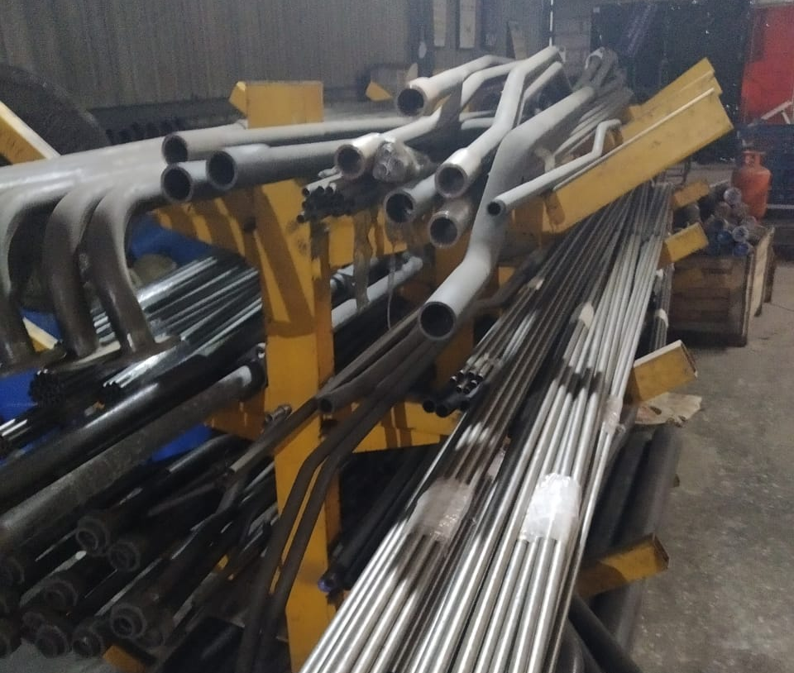
Removal Of Corrosive Part from Pipes.
Next step is to clean the pipe by applying solution to it so that there are no possibilities of corrosion further. Pipe is kept in solution for some time and later it is cleaned by cloth ,solution is applied from inside also with the help of drill like machine and later processed for bending to a desired shape. This process is first done for small OD because applying solution to pipe after bending is difficult. For OD > 32mm, job is made first and later processed for applying solution.

Slide 11
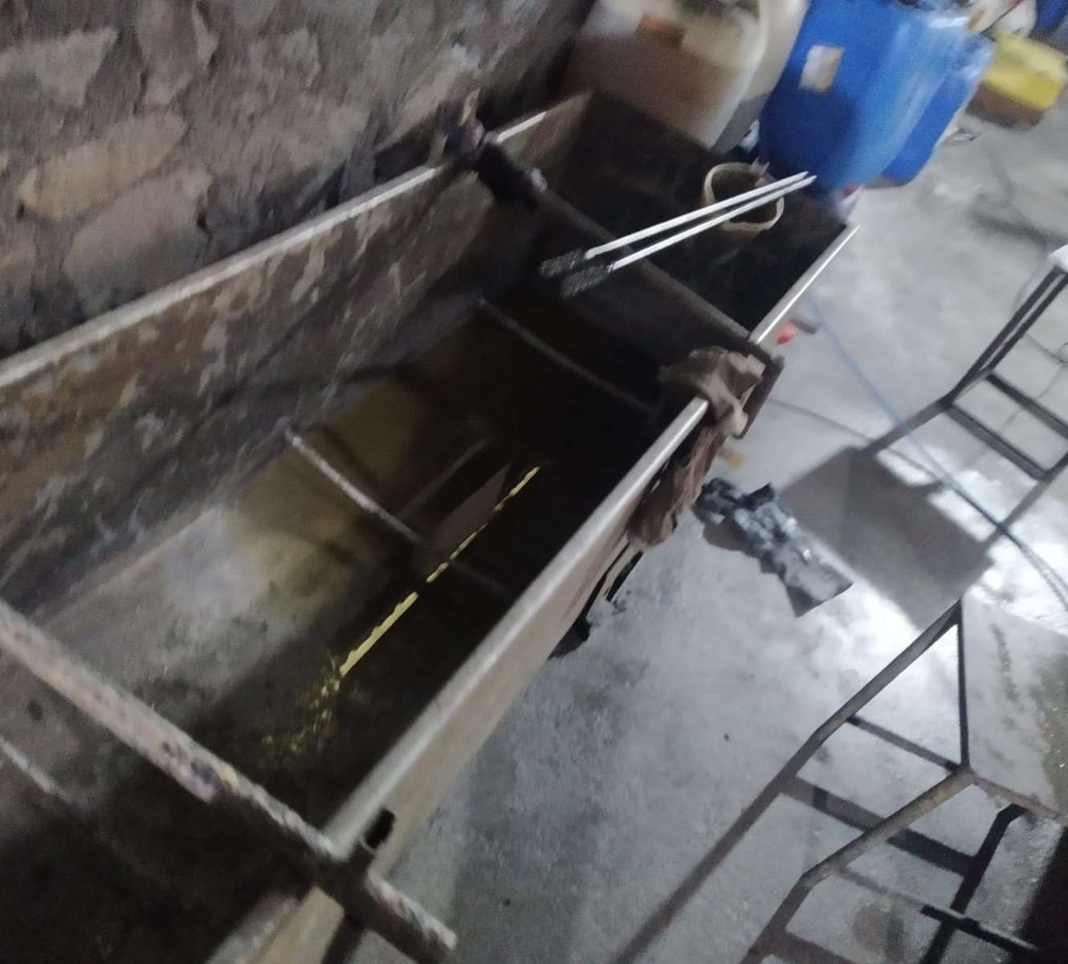
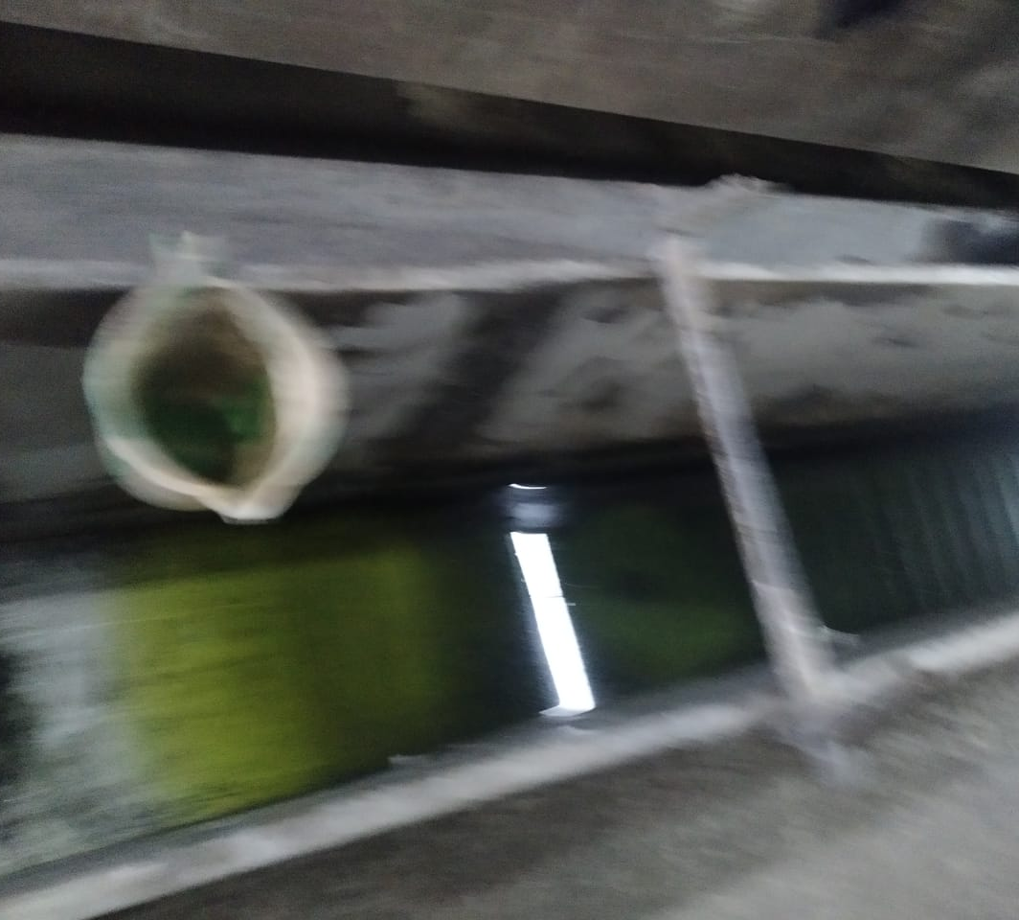
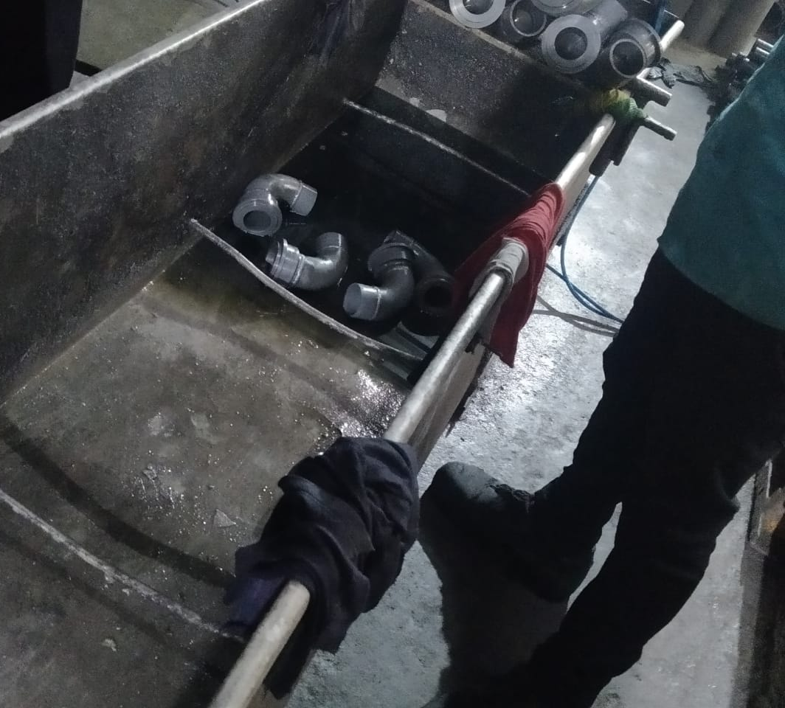
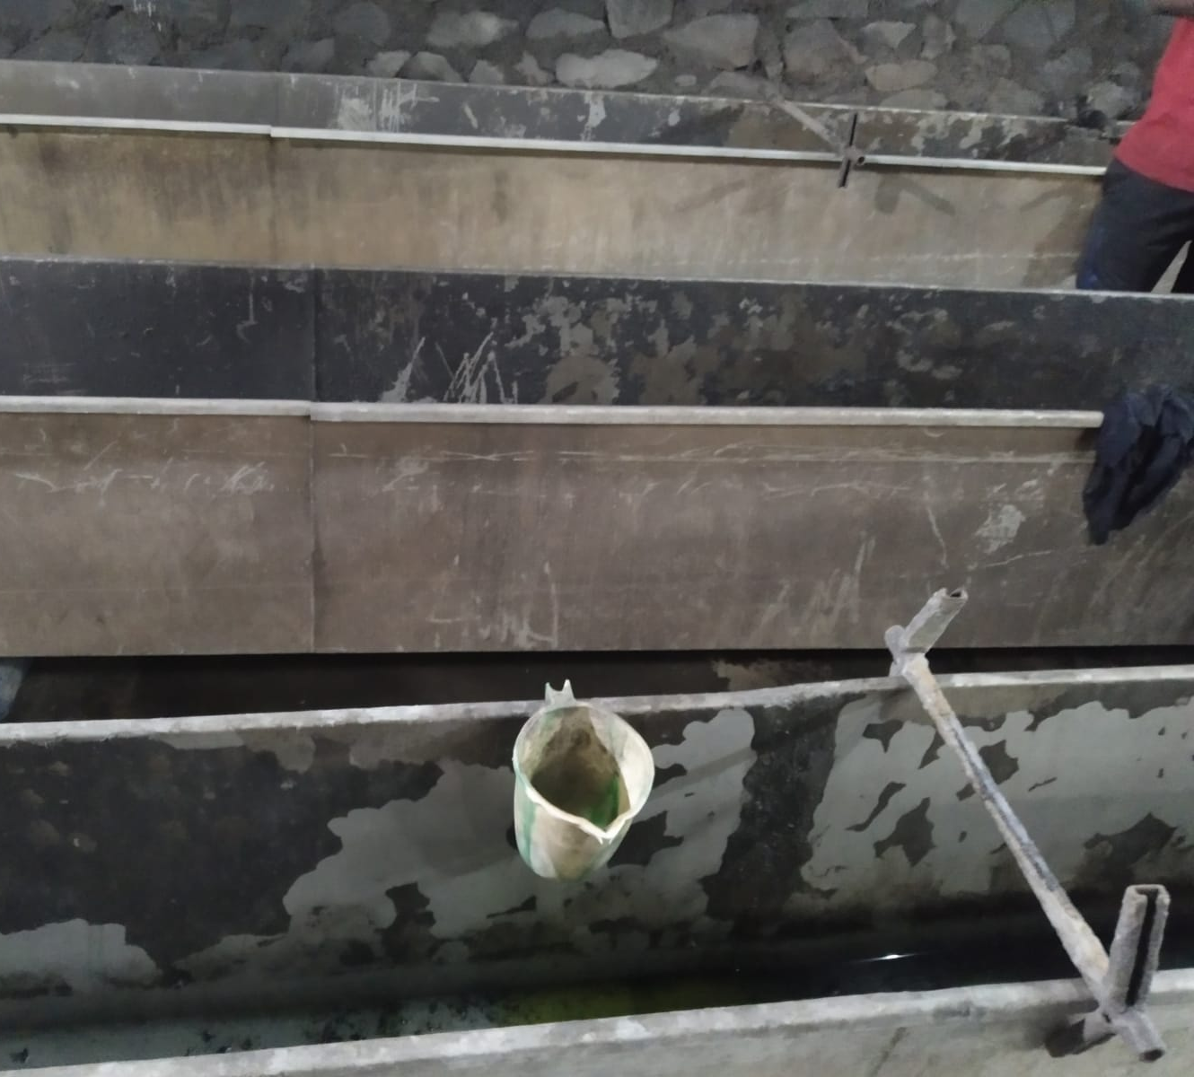
Process to remove corrosive part
1st step is to clean the job, job is merged in nanocoat solution for 30 mins to clean the job well.
While changing the solution section, job is cleaned with cotton cloth and air is given to it, later submerged in another solution.
Next step, it is kept in diesel so as to clean the inner part of job well it is also kept for almost 20 – 30 mins
Later finally it is cleaned with oil and again air is given to remove excess oil, finally job is cleaned and ready for next process.

Slide 12
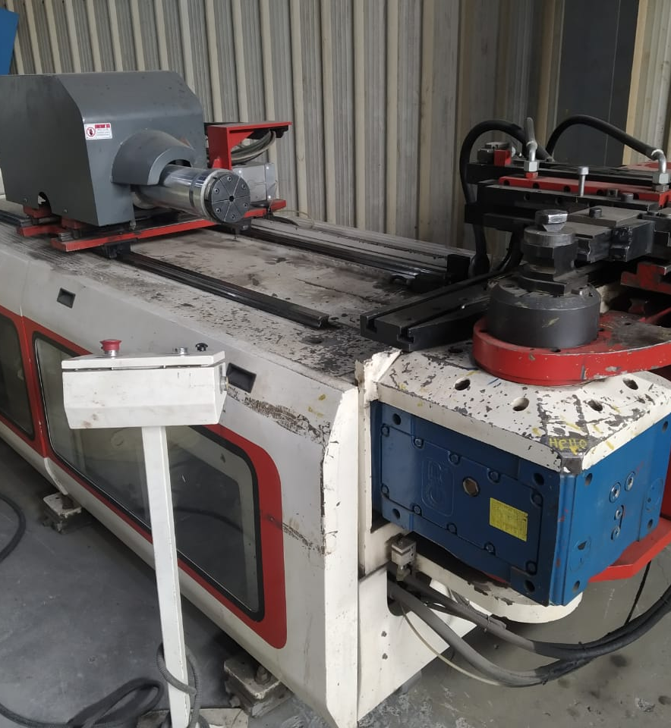
Pipe Bending Machine
Small OD pipes are bended directly with the help of programming in machine according to design given by customer, later the job is completed it is processed to quality engineer to check the job accuracy.
For big OD pipes are bended and later send to welding section and are welded to various section according to design later processed for threading to a firm and threader is installed

Slide 13
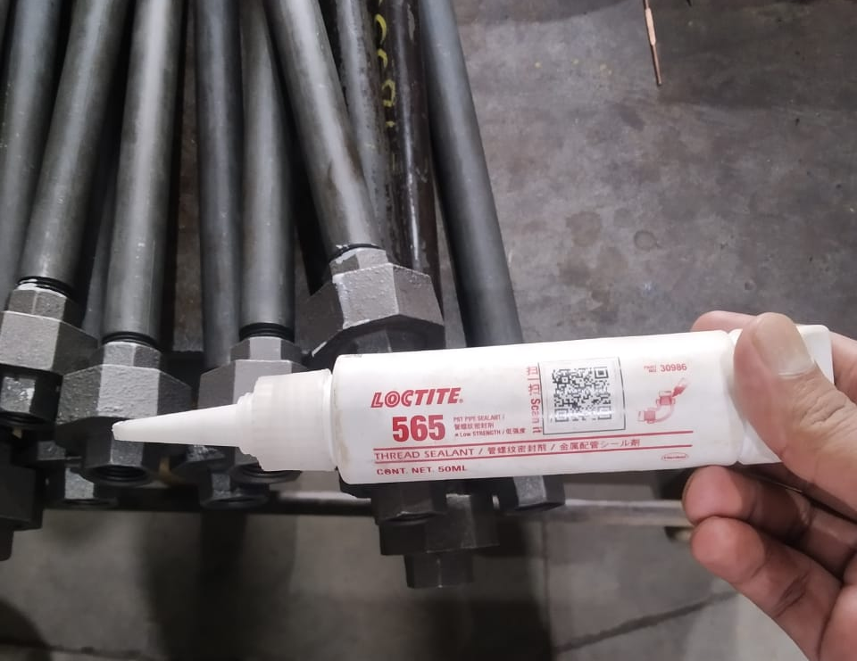
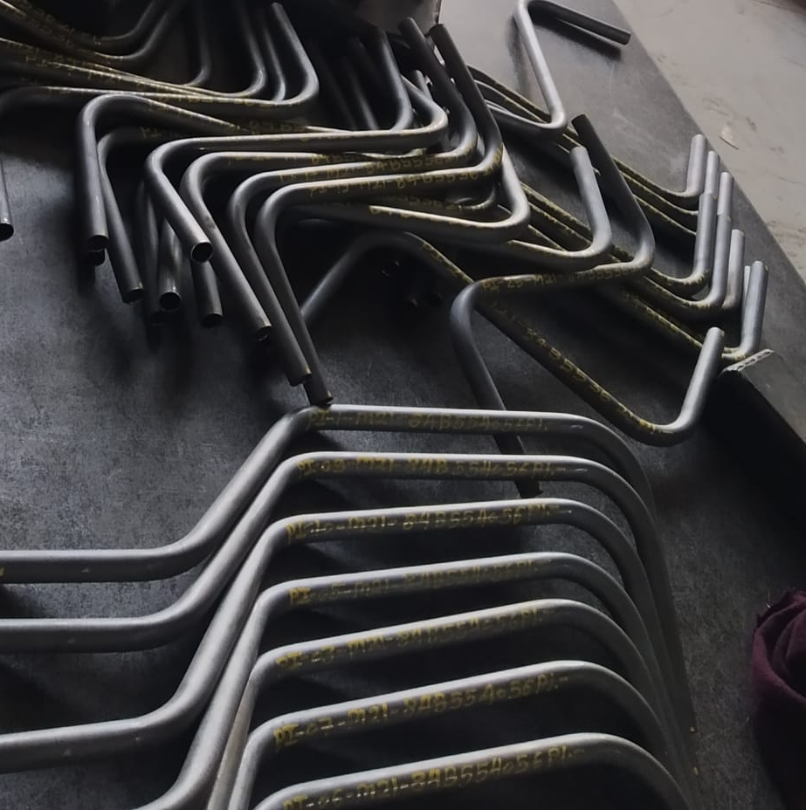
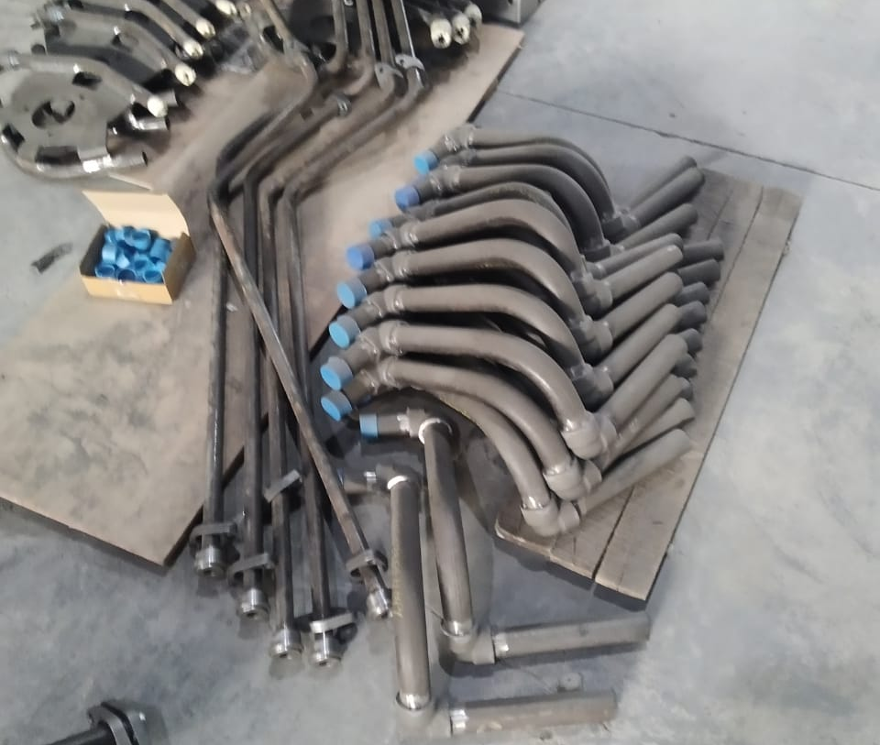
Big OD Pipe Process
After bending is done, as per requirement or design the portion is welded at end and processed for threading and bolt is installed later.
In fabrication section ,welder weld the pipes according to design given to them usually there is fillet weld on corner and straight pipe and further processed to check the accuracy ,later after processing of threading is done and flange nuts are used as per requirement.
After this process, solution is applied on it to avoid rusting, later thread sealant is used at part of threader while putting the flange nut on pipe and cap is used at another end.

Slide 14
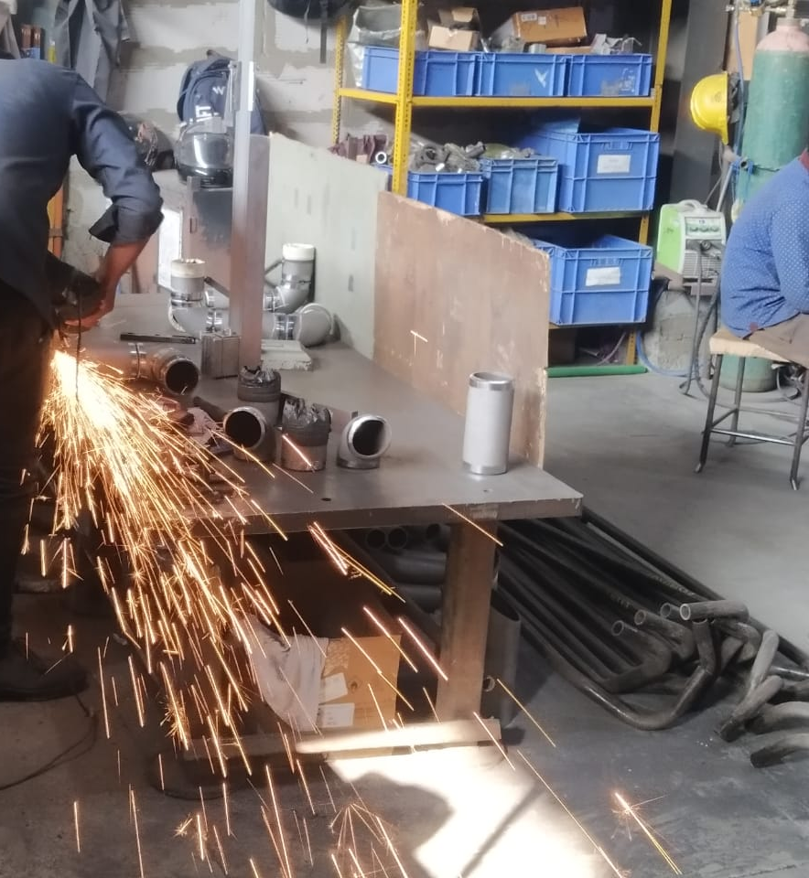
Fabrication
After bending job is done, it is sent to fabrication department for welding.
Here after blasting process is done, the helper removes the initial process with help of grinder.
Later welding is done at a bracket where weld is represented in diagram and welder weld at some point with help of filler.
Later another welder welds the whole section fully.
When Mig(CO2) welding is done, there is lap of extra weld at a particular point and some small weld particles are there around the welding part.
Later with the help of grinder the extra portion is removed and mig welding spot are also removed later and further process is done.

Slide 15
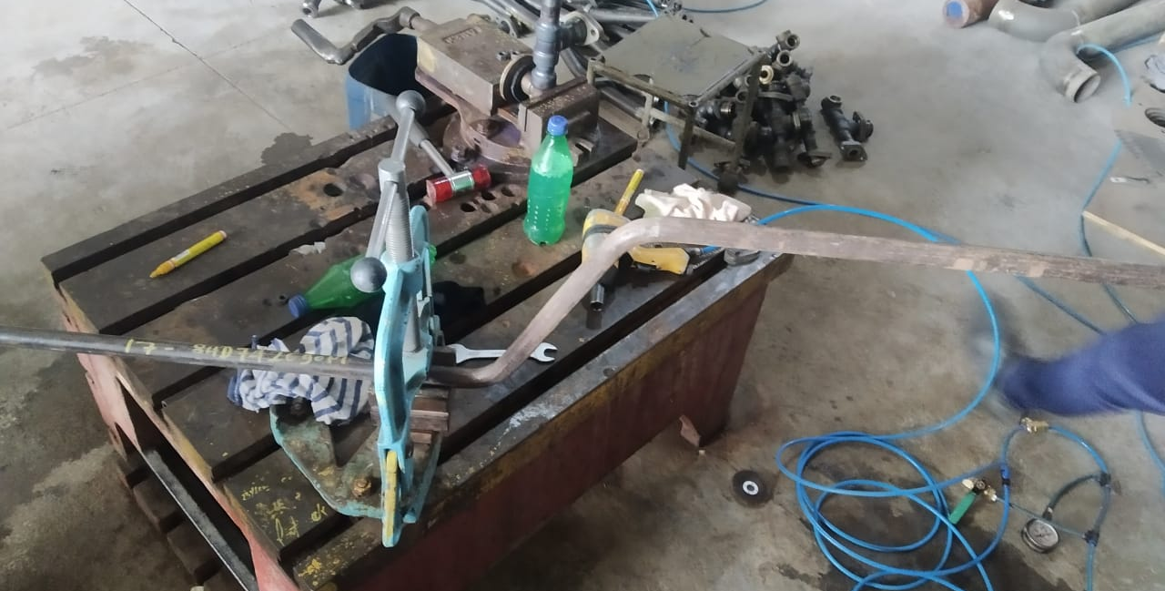
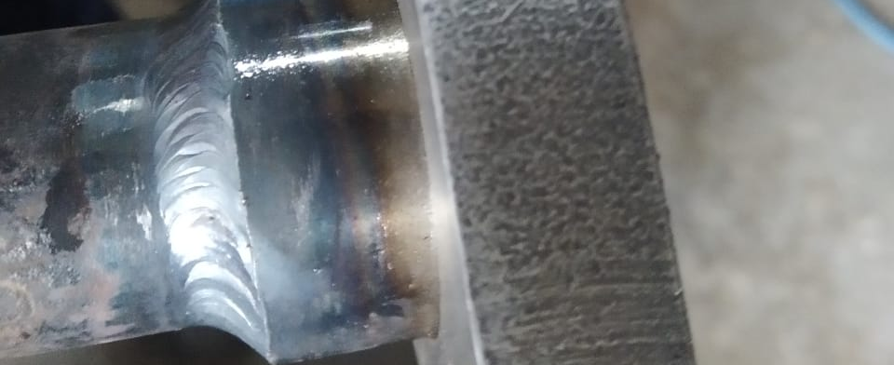
Leakage Testing
Pipes manufactured in the factory are made for purpose of passing the air (gas).
Air is passed through it and pressure is maintained and pipe is cheaked accordingly.
With the help of water, leakage is checked at the point of fillet weld.
L.T ok mark is written on pipe for further process.

Slide 16
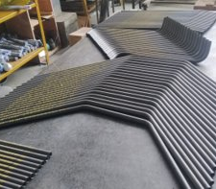
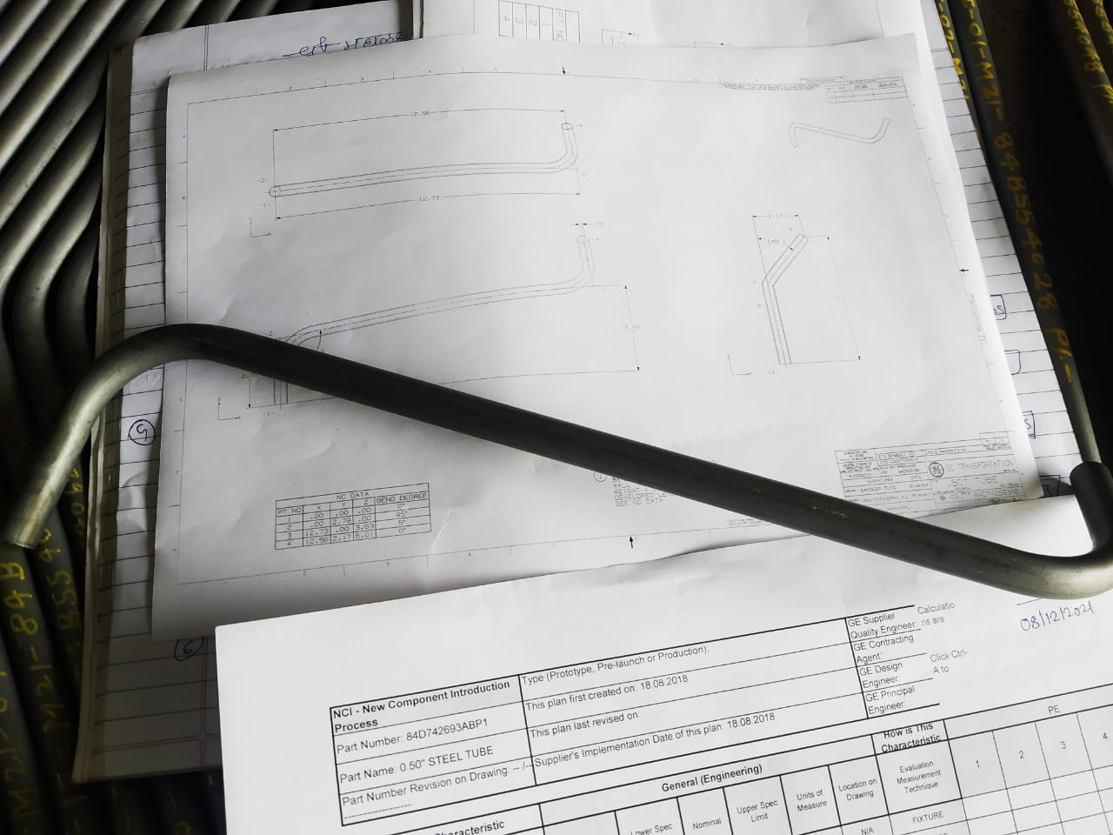
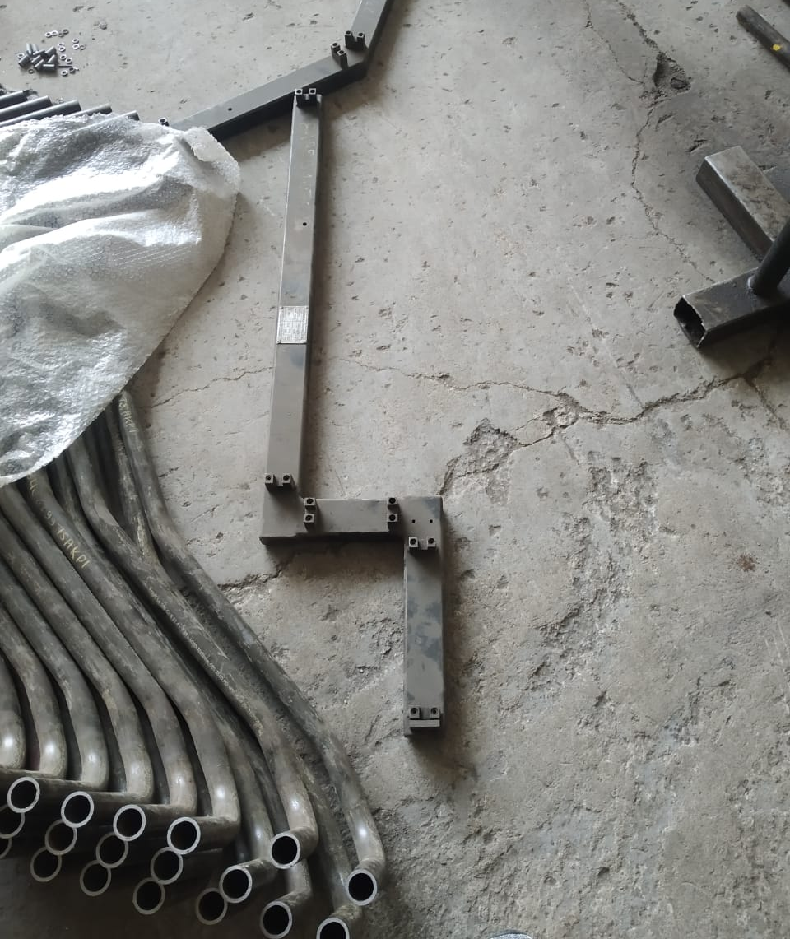
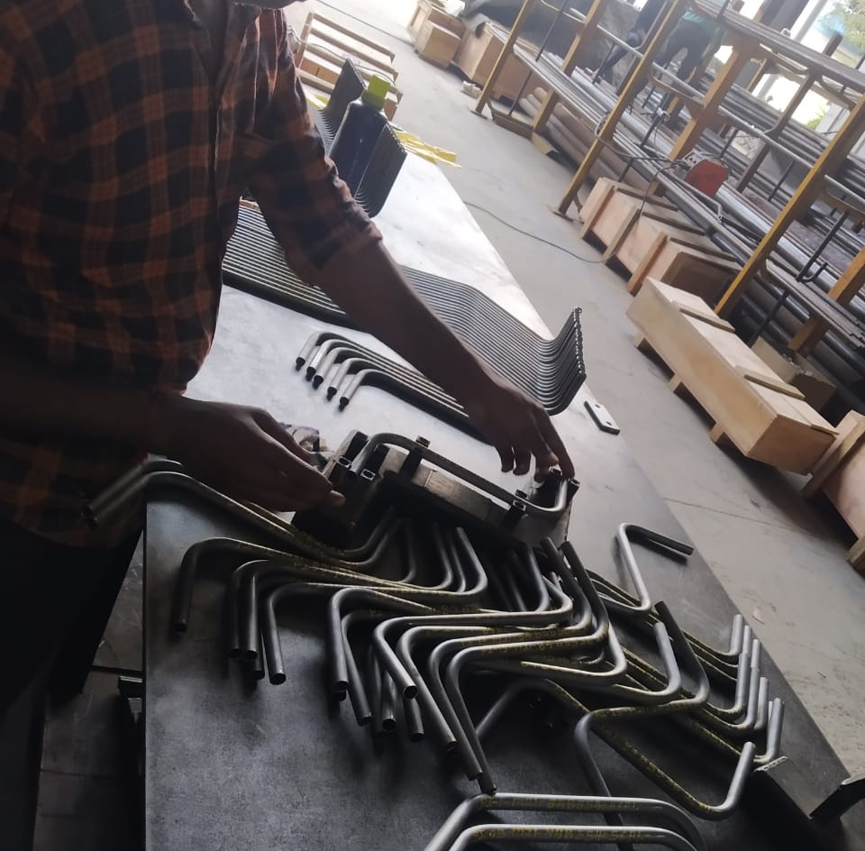
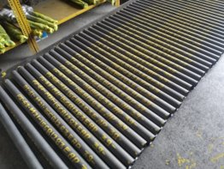
Packaging
After verifying leakage testing oil is applied for final cleaning purpose to avoid rust further.
Oil is applied from inside and outside
Air is used to remove excess oil (nanocoat).
Chassis no. is written on each pipe according to convention of customer and pentanen (PI-01-xxxxxxxxxxx)
Fixture is designed according to requirement and each pipe is verified in front of quality engineer so that no defective piece is send to customer.

Slide 17
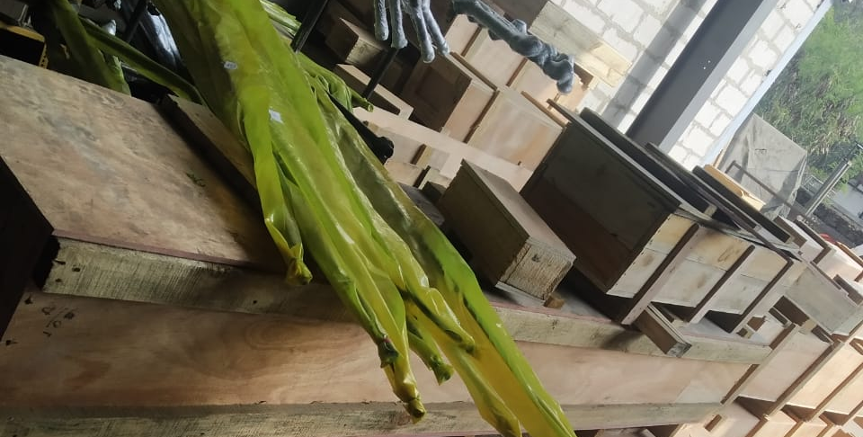
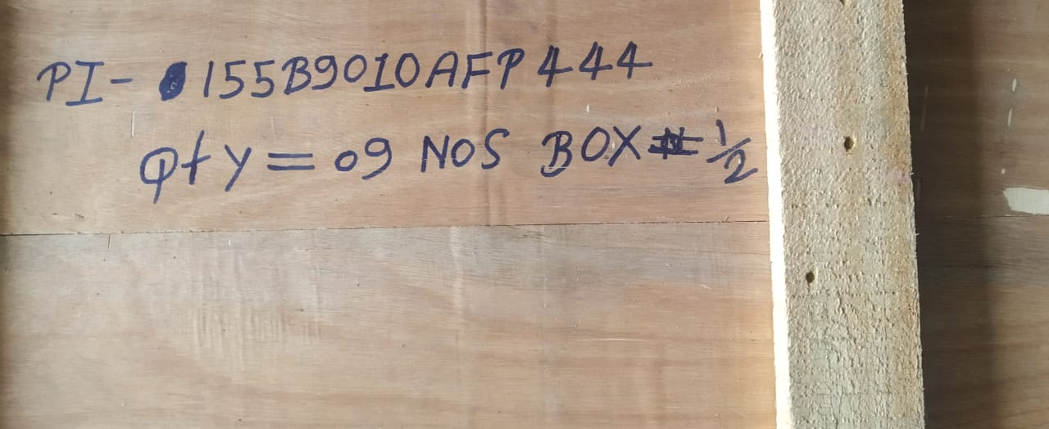
Dispatching
Quality checks the design again with the help of reference drawing given by customer.
Each pipe is packed in separate plastic bag and wrapped up with plastic, sticker with specific no. is applied on job and packed in transportation box.
Finally Dispatch is done to customer.

Slide 18
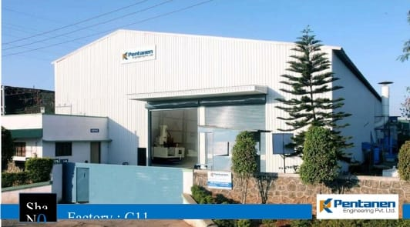
THANK YOU

Slide 19
